Slide 1
Car Dealership Dashboard Application with JSON API using PostgreSQL database running on Docker container
David Sosa

Slide 2
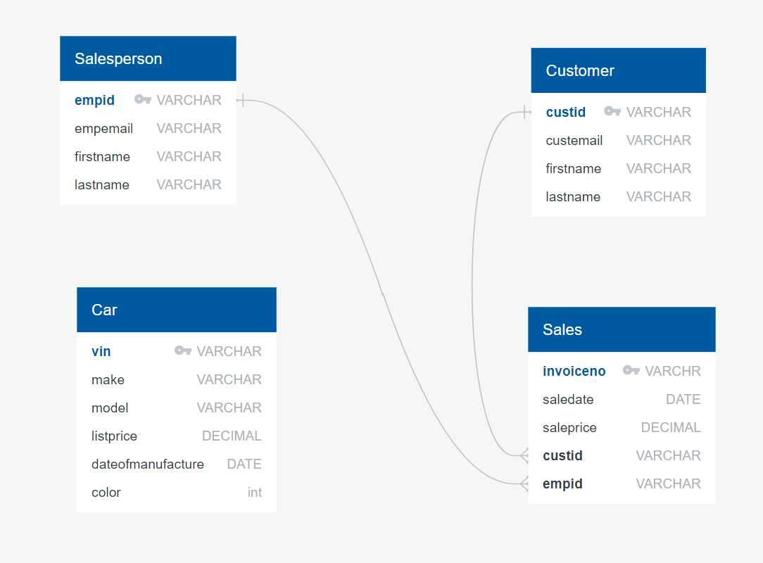
Data model includes 4 tables – one for employees, customers, sales, and cars
Each table has a primary key and the Sale table has a foreign key relationship with the Salesperson table and the Customer table

